Slide 1
Chapter 5: Process Scheduling

Slide 2
Chapter 5: Process Scheduling
Basic Concepts
Scheduling Criteria
Scheduling Algorithms
Thread Scheduling
Multiple-Processor Scheduling
Operating Systems Examples
Algorithm Evaluation

Slide 3
Objectives
To introduce process scheduling, which is the basis for multiprogrammed多程序 operating systems
To describe various process-scheduling algorithms
To discuss evaluation criteria評估準則 for selecting a process-scheduling algorithm for a particular system
Notes:
Ok 假設設計好一個排程的Algo 怎麼評估呢 1 simulation跑模擬 2 數學分析 理論值 3 實際做出來 實際環境去測量
為了不讓CPU idle時間太長 會把好幾個process 放在記憶體 也有放再ready queue的機制 再去挑 一個發生IO的時候 其他就可以繼續執行

Slide 4
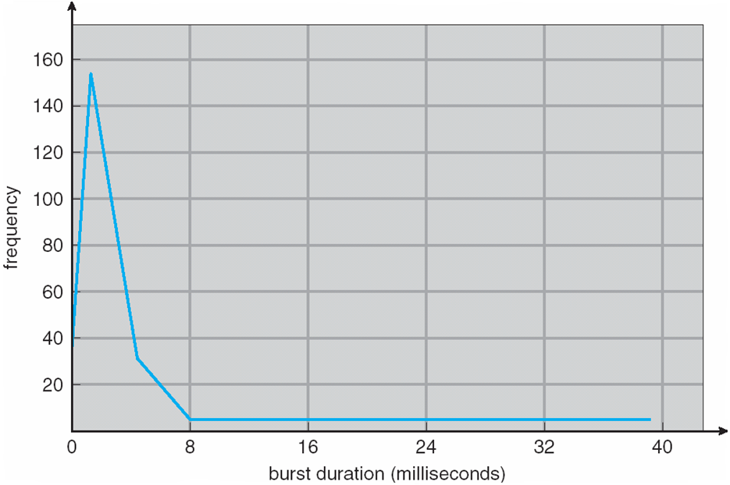
Basic Concepts
Maximum CPU utilization利用率 obtained with multiprogramming
CPU–I/O Burst爆炸 Cycle – Process execution consists of a cycle of CPU execution and I/O wait
CPU burst distribution分布 可看出實際CPU在使用的時間段
Notes:
這張圖的分布說明就是下頁

Slide 5
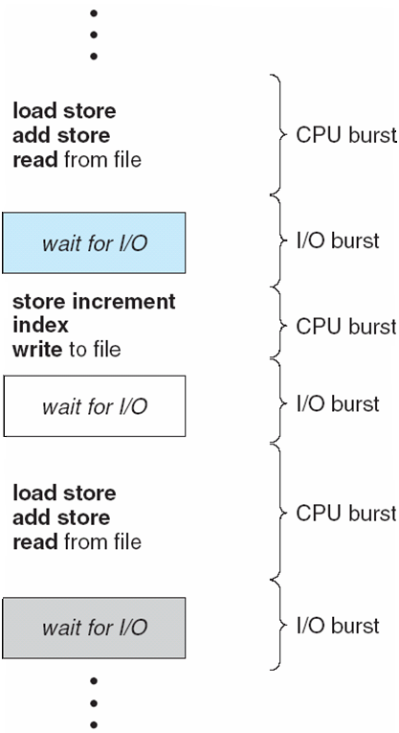
Histogram直方圖 of CPU-burst Times
155
2ms
Alternating Sequence of CPU And I/O Bursts
Notes:
IO的時候CPU就不使用 IO結束CPU就爆發使用 IO完之前說waiting state會先轉到Ready state / Ready Queue 右邊圖是所有CPU執行的時間累加起來 x軸時間長度 y軸發生幾次 所以紅垂直線 就是說 一次執行時間長度是 2ms的總次數有155次 所以執行時間很長的 次數 很少 短時間的次數較多 可知CPU時間分部

Slide 6
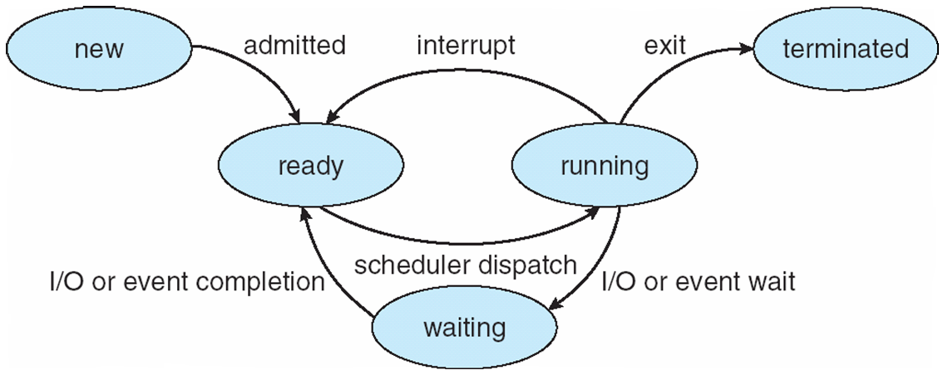
CPU Scheduler 排程 在做vvv
Selects from among the processes in memory that are ready to execute, and allocates the CPU to one of them
CPU scheduling decisions may take place when a process:
1. Switches from running to waiting state (I/O Request)
2. Switches from running to ready state (Timer timeout)
3. Switches from waiting to ready (I/O Completed)
4. Terminates
Scheduling under 1 and 4 is nonpreemptive
All other scheduling is preemptive(先買權)
Preemptive > 一隻程式在跑 把他停下來 CPU搶過來
換另一隻跑 nonpr..不可搶
Notes:
例如目前狀態 有一個p從wait > ready 就可能要考慮是不是要換一隻running得下來 丟一隻ready的上去 同理程式終止也可能要考慮對其他隻做新的安排

Slide 7
Dispatcher發送者/調度員
Dispatcher 軟體模組module gives control of the CPU to the process selected by the short-term scheduler; this involves: 把CPU透過演算法挑一個proc給他用
switching context stack資結要存
switching to user mode 一般程式在user m執行
jumping to the proper location in the user program to restart that program
Dispatch latency 切換花的時間 – time it takes for the dispatcher to stop one process and start another running跟前一章的圖相同 每個程式切換時間可能不同 這個時間不算在對效率沒幫助所以不希望太頻繁

Slide 8
Scheduling Criteria 排程考量準則
CPU utilization利用 – keep the CPU as busy as possible
Throughput生產量 – # of processes that complete their execution per time unit
Turnaround time – amount of time to execute a particular process 程式開始執行到結束的時間
開始>進ready Q > CPU >IO >CPU 在state轉轉…結束
Waiting time – amount of time a process has been waiting in the ready queue rQ裡的等待時間 exGame越短越好
Response time – amount of time it takes from when a request was submitted until the first response is produced, not output (for time-sharing environment)

Slide 9
Scheduling Algorithm Optimization Criteria
Max CPU utilization
Max throughput
Min turnaround time
Min waiting time
Min response time

Slide 10
First-Come, First-Served (FCFS) Scheduling
Process Burst Time
P₁ 24
P₂ 3
P₃ 3
Suppose that the processes arrive in the order: P₁ , P₂ , P₃ The Gantt Chart for the schedule is:
Waiting time for P₁ = 0; P₂ = 24; P₃ = 27
Average waiting time: (0 + 24 + 27)/3 = 17
P₁
P₂
P₃
0
24
27
30
Notes:
5-3

Slide 11
FCFS Scheduling (Cont)
Suppose that the processes arrive in the order
P₂ , P₃ , P₁
The Gantt chart for the schedule is:
Waiting time for P₁ = 6; P₂ = 0; P₃ = 3
Average waiting time: (6 + 0 + 3)/3 = 3
Much better than previous case
Convoy effect 護航效應 : short process behind long process
P₂
P₃
P₁
0
3
6
30
P₁
P₂
P₃
0
24
27
30
Notes:
Convey Eff > 短排在長的後面 就會導致平均等待時間變長

Slide 12
Shortest-Job-First (SJF) Scheduling
Associate with each process the length of its next CPU burst. Use these lengths to schedule the process with the shortest time
SJF is optimal – gives minimum average waiting time 等待時間最佳解for a given set of processes
The difficulty is knowing the length of the next CPU request不確定預知後面每個p要跑多久 但可預測

Slide 13
Example of SJF
Process Burst Time
P₁ 6
P₂ 8
P₃ 7
P₄ 3
SJF scheduling chart
Average waiting time = (3 + 16 + 9 + 0) / 4 = 7
P₄
P₁
P₃
P₂
0
3
9
16
24

Slide 14
Determining Length of Next CPU Burst
Can only estimate the length
Can be done by using the length of previous CPU bursts, using exponential averaging
Notes:
5-4 用過去推測未來 t 真正時間 ㄊㄠ預測時間

Slide 15
Examples of Exponential Averaging
α =0 完全不看實際執行>不準
τ_{n+1} = τ_{n}
Recent history does not count
α =1 只看最後一次
τ_{n+1} = t_{n}
Only the actual last CPU burst counts
If we expand the formula, we get: 越前面的項影響越大
τ_{n+1} = α t_{n}+(1 - α)α t_{n} -1 + …
+(1 - α )^{j} α t_{n} _{-j} + …
+(1 - α )^{n +1} τ₀
Since both α and (1 - α) are less than or equal to 1, each successive term has less weight than its predecessor

Slide 16
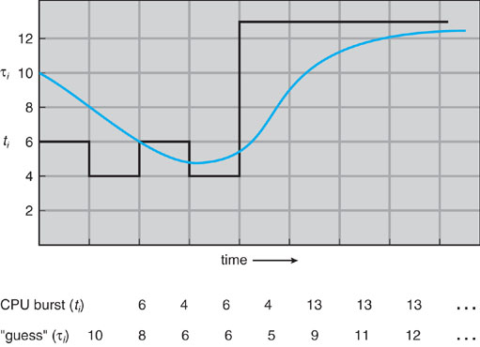
Prediction of the Length of the Next CPU Burst
(α = 1/2, τ₀ =10)
Notes:
看動畫更好懂 右斜線上去 預測10 實際6 > 10*1/2+6*1/2 = 8 實際4 類推 希望藍線(預測)盡量靠近黑線(實際) 如果猜不準 就會影響排程的順序 OS 還是能run 只是像是 SJF 縮短平均等待時間的效果就沒那麼好

Slide 17
Example of SJF
Process Arrival Time Burst Time
P₁ 0 8
P₂ 1 4
P₃ 2 9
P₄ 3 5
SJF scheduling chart
Average waiting time = ? 自己算
一開始p1 時間1 有p2更短的進來 就讓p2優先執行>preemptive 這個
P₁
P₂
P4
P₁
P₃
0
1
5
10
17
26
Notes:
時間5 p2結束 > p1剩7 p3 9 p2 4 > p2最短先跑 avg> p1:0+10 p2:0 p3:15 p4:2 33/4 = 8.25 >如果FCFS 0+8+12+21 = 41/4=10.25

Slide 18
Priority Scheduling
A priority number (integer) is associated with each process
The CPU is allocated to the process with the highest priority (smallest integer ≡ highest priority)
Preemptive prior也有分這兩種 pre>執行中途有pri更高進來就搶(就給他)
Nonpreemptive 不影響執行中p p結束下次挑最高pri
SJF is a priority scheduling where priority is the predicted next CPU burst time
Problem ≡ Starvation飢餓 – low priority processes may never execute
Solution ≡ Aging年資高調高增加機會OS常用手法 – as time progresses increase the priority of the process

Slide 19
Round Robin (RR)輪流
Each process gets a small unit of CPU time (time quantum)時間單位, usually 10-100 milliseconds.
After this time has elapsed, the process is preempted先佔 and added to the end of the ready queue(timeout).
If there are n processes in the ready queue and the time quantum is q, then each process gets 1/n of the CPU time in chunks of at most q time units at once. No process waits more than (n-1)q time units. 若有p提早end就會減短wait
Performance
q large ⇒ FIFO 都可以run完 同FCFS RR效果差
q small ⇒ q must be large with respect to context switch, otherwise overhead 頭頂/高架的is too high
Notes:
q太小 切換太頻繁>CPU使用效率差 q太長 > waiting time長

Slide 20
Example of RR with Time Quantum = 4
Process Burst Time
P₁ 24
P₂ 3
P₃ 3
The Gantt chart is:
Typically, higher average turnaround than SJF, but better response
P₁
P₂
P₃
P₁
P₁
P₁
P₁
P₁
0
4
7
10
14
18
22
26
30

Slide 21
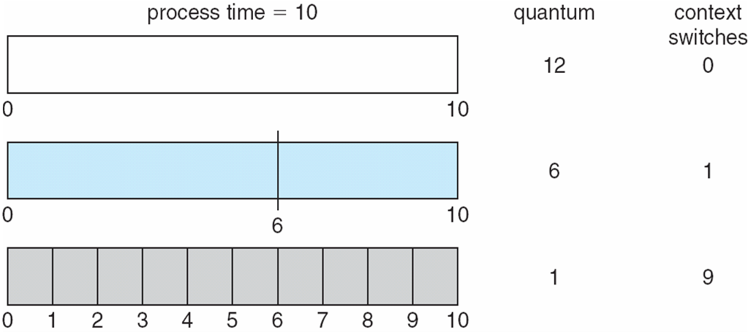
Time Quantum and Context Switch Time

Slide 22
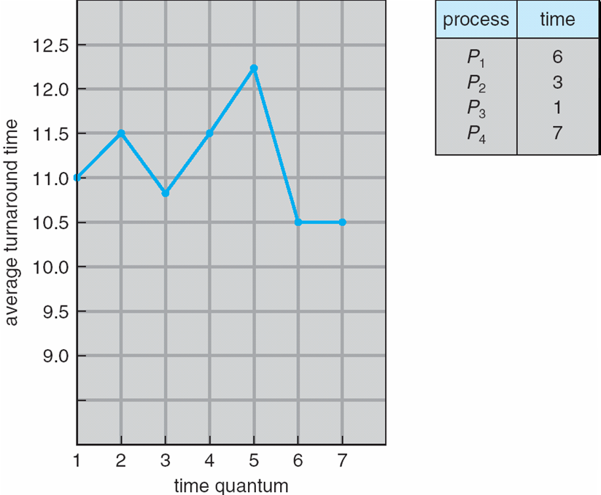
Turnaround Time Varies With The Time Quantum
5,3,1,5,1,2 = 15+8+9+17
= 49/4 = 12.25
6,3,1,6,1 = 6+9+10+17
= 42/4 = 10.5
6,3,1,7 = 6+9+10+17
= 42/4 = 10.5
Notes:
x 不同 time q 得到不同 y turnaround time

Slide 23
Multilevel Queue
Ready queue is partitioned into separate queues: foreground (interactive) background (batch)
Each queue has its own scheduling algorithm
foreground – RR
background – FCFS
Scheduling must be done between the queues
Fixed priority scheduling; (i.e., serve all from foreground then from background). Possibility of starvation. 解法如下:
Time slice – each queue gets a certain amount of CPU time which it can schedule amongst its processes; i.e., 80% to foreground in RR, 20% to background in FCFS
Notes:
一個queue 能用不同schedule algo來排 多個queue就如上說明 程式分兩大類 CPU bound(也就是batch) IO bound(IO頻繁 例如說game 頻繁互動的)

Slide 24
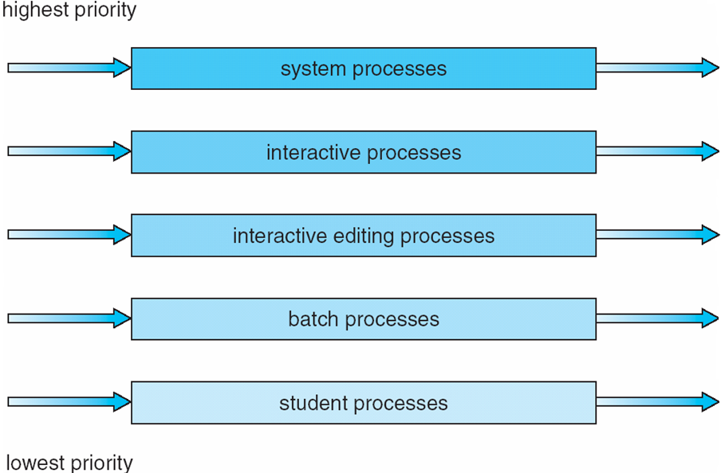
Multilevel Queue Scheduling

Slide 25
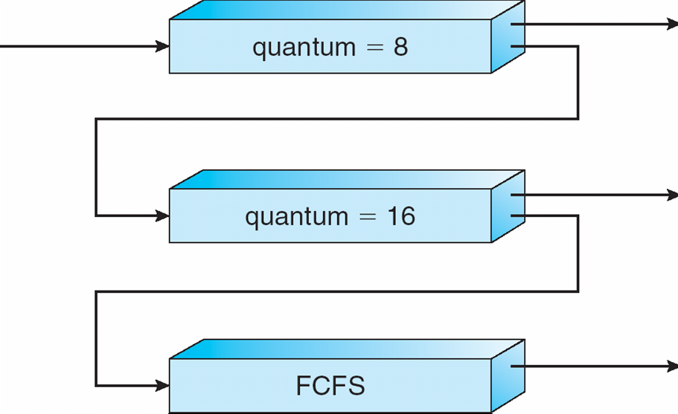
Multilevel Feedback Queue
A process can move between the various queues; aging can be implemented this way
Multilevel-feedback-queue scheduler is defined by the following parameters:
number of queues
scheduling algorithms for each queue
method used to determine when to upgrade a process
method used to determine when to demote降級 a process
method used to determine which queue a process will enter when that process needs service

Slide 26
Example of Multilevel Feedback Queue
Three queues:
Q₀ – RR with time quantum 8 milliseconds
Q₁ – RR time quantum 16 milliseconds
Q₂ – FCFS
Scheduling
A new job enters queue Q₀ which is served FCFS. When it gains CPU, job receives 8 milliseconds. If it does not finish in 8 milliseconds, job is moved to queue Q₁.
At Q₁ job is again served RR and receives 16 additional milliseconds. If it still does not complete, it is preempted and moved to queue Q₂.
Notes:
這裡有個問題 Q0 Q1不是都說RR了 怎麼底下還說 Q0 Q1 FCFS 應該是寫錯 我直接幫他改掉 要怎麼訂feedback切換queue的規則 就是看目的是什麼 例如說CPU使用率最高 或是throughput最大 或是respond time最短 再去設計 給OS執行

Slide 27
Multilevel Feedback Queues

Slide 28
Thread Scheduling
User-level threads are managed by a thread library, and the kernel is unaware of them
To run on a CPU, user-level threads must ultimately be mapped to an associated kernel-level thread, although this mapping may be indirect and may use a LWP (Light Weight Process).前一章有說
Contention Scope 論點主張爭奪
process-contention scope (PCS)
system-contention scope (SCS)
One distinction between user-level and kernel-level threads lies in how they are scheduled.
Notes:
前面是process的schedule 這邊就是Thread的schedule Contention Scope 要跟誰競爭 競爭的範圍對象是誰 scs就是跟整個system的kernel th競爭 pcs是跟proc裡的

Slide 29
Thread Scheduling
Many-to-one and many-to-many models, thread library schedules user-level threads to run on an available LWP (Light Weight Process) 前章有
Known as process-contention scope (PCS) since scheduling competition is among threads belonging to the same process
When we say the thread library schedules user threads onto available LWPs, we do not mean that the thread is actually running on a CPU; this would require the OS to schedule the kernel thread onto a physical CPU.
To decide which kernel thread to schedule onto a CPU, the kernel uses system-contention scope (SCS)
Notes:
排在LWP上布代表馬上可用CPU 還要等OS去安排對應的Kernel Th的動作

Slide 30
Thread Scheduling
Competition for the CPU with SCS scheduling takes place among all threads in the system.
System using the one-to-one model, schedule threads using only SCS.(也可能是many to one many to many)
Typically, PCS is done according to priority – the scheduler selects the runnable thread with the highest priority to run. User-level thread priorities are set by the programmer and are not adjusted by the thread library.
The PCS will typically preempt the thread currently running a favor of higher-priority thread; however there is no guarantee of time slicing among threads of equal priority.
Notes:
system-contention scope (SCS) process-contention scope (PCS) PCS 的 preempt: 高優先權的th復活的時候 可以掠奪正在執行中較低優先權的Th的CPU 拿來執行

Slide 31
Pthread Scheduling
API allows specifying指定 either PCS or SCS during thread creation
PTHREAD SCOPE PROCESS schedules user-level threads using PCS scheduling 自己proc裡的多個Th競爭底下的一些LWP 有多少個LWP 會由OS量測proc的效率/停滯時間等 決定給多少
PTHREAD SCOPE SYSTEM schedules threads using SCS scheduling.一對一對應的一定是SCS 跟system的所有kenel th競爭
Will create and bind an LWP for each user-level thread on many-to-many systems, effectively mapping threads using the one-to-one policy.
要套用SCS是透過一個LWP綁定對到一個Kernel Th
LWP上面跟user th可能可多對多但到sys就是一對一
Notes:
process-contention scope (PCS) system-contention scope (SCS) Thread有三大系統 pThread / win32 / java virtual machine

Slide 32
POSIX執行緒[編輯]
維基百科，自由的百科全書
跳至導覽跳至搜尋POSIX執行緒（英語：POSIX Threads，常被縮寫為Pthreads）是POSIX的執行緒標準，定義了創建和操縱執行緒的一套API。
實現POSIX 執行緒標準的庫常被稱作Pthreads，一般用於Unix-like POSIX 系統，如Linux、 Solaris。但是Microsoft Windows上的實現也存在，例如直接使用Windows API實現的第三方庫pthreads-w32；而利用Windows的SFU/SUA子系統，則可以使用微軟提供的一部分原生POSIX API。
https://zh.wikipedia.org/wiki/POSIX%E7%BA%BF%E7%A8%8B

Slide 33
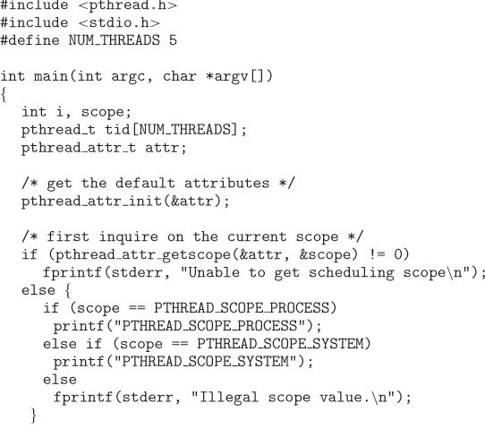
Pthread Scheduling API
Notes:
process-contention scope (PCS) system-contention scope (SCS) 底下有判斷是 == SCS PCS

Slide 34
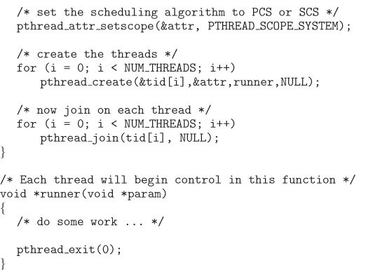
Pthread Scheduling API
Notes:
process-contention scope (PCS) system-contention scope (SCS) 設成SCS for create 5 個 th join等待全部th執行完

Slide 35
Multiple-Processor Scheduling
CPU scheduling more complex when multiple CPUs are available
Homogeneous相同的 processors within a multiprocessor
Asymmetric multiprocessing (AMP) –
All scheduling decisions, I/O processing, and other system activities handled by only a single processor- the master server.
The other processors execute only codes.
Only one processor accesses the system data structures, reducing the need for data sharing
Notes:
Asymmetric 在離散是 A->B 則不會 B->A 但他只說一個Master 那叫Master Slave 就行啦 master管理 其他人執行 比較不用data sharing

Slide 36
Homogeneous 我看這篇看起來比較準 好像就同型號的多個CPU 所以各方面都相同
https://superuser.com/questions/1266745/homogeneous-cores-and-heterogeneous-cores#

Slide 37
Multiple-Processor Scheduling
Symmetric multiprocessing (SMP) –
each processor is self-scheduling,
all processes in common ready queue, or
each has its own private queue of ready processes
Processor affinity密切關係 – process has affinity for processor on which it is currently running
soft affinity – a process is possible to migrate between processors
hard affinity – a process is not to migrate to other processor
Notes:
Soft affinity 一個proc在一個procr執行>IO>waiting>IO done>ready>可以用不同的另一個procr跑 hard都在同一個procr跑

Slide 38
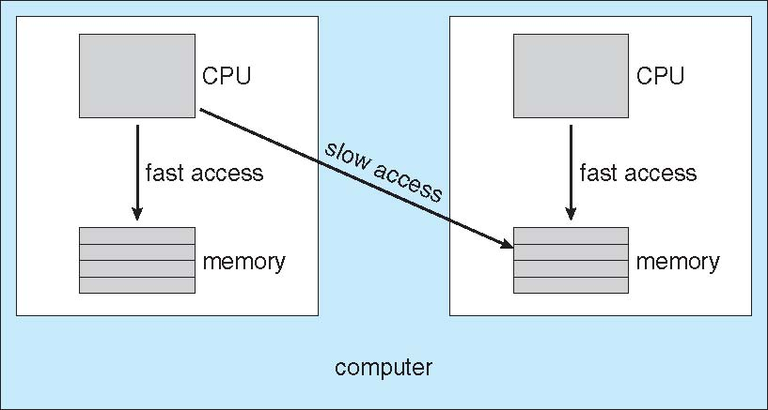
NUMA and CPU Scheduling
The main memory architecture can affect processor affinity issues.
An architecture featuring non-uniform memory access (NUMA) , in which a CPU has faster access to some parts of main memory than to other parts.
Notes:
要避免slow acc 就是盡量一個proc都在同一個procr上面跑

Slide 39
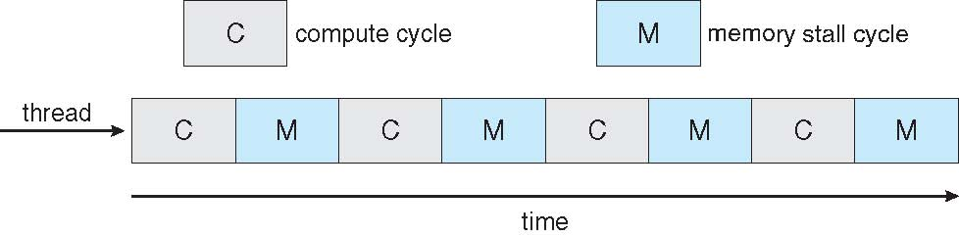
Multicore Processors
Recent trend to place multiple processor cores on same physical chip
Faster and consume less power
Memory stall – when a processor accesses memory, it spends a significant amount of time waiting for the data to become available.

Slide 40
Multicore Processors
Multiple threads per core also growing
Takes advantage of memory stall to make progress on another thread while memory retrieve happens ok前面好像哪邊有說過
Thread₁
Thread₀

Slide 41
Operating System Examples
Solaris scheduling
Windows XP scheduling
Linux scheduling

Slide 42
Solaris scheduling
Solaris uses priority-based thread scheduling where each thread belongs to one of six classes:
Time sharing (TS) 類似RR 執行一段時間CPU就拉回來
Interactive (IA) 互動性
Real time (RT) 即時
System (SYS)
Fair share (FSS)
Fixed priority (FP)
Within each class there are different priorities and different scheduling algorithms. FCFS SJF RR /multiQ multiFeedbackQ
Default class for a process is time sharing.

Slide 43
Solaris scheduling
The scheduling policy for the time-sharing class dynamically alters priorities and assigns time slices(quantum) of different length using a multiple feedback queue.
There is an inverse relationship between priorities and time slices. 越優先每次給的CPU越短/少 互動性高 很快就產生IO 就走開了
The following table shows dispatch table for time-sharing and interactive threads.
These two scheduling classes include 60 priority levels.

Slide 44
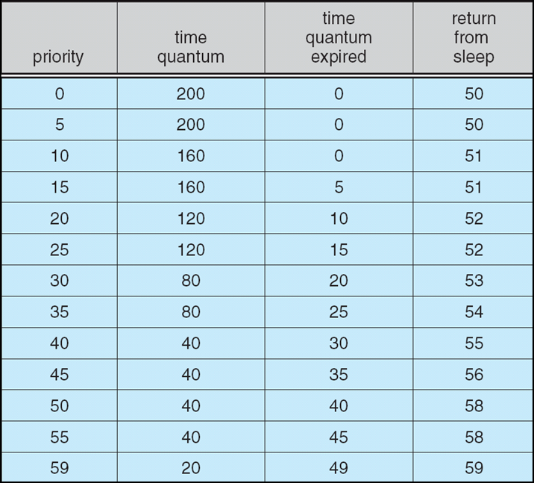
Solaris Dispatch Table
Solaris dispatch table for time-sharing and interactive threads
Notes:
最左0~59個pri 以55高pri為例 timeQ只給40少 如果完全用完40 下次排就降級到45(越降CPU時間給越多) 執行不到40就結束>58更優先 pri=15是另個例子 有點類似

Slide 45
Solaris scheduling
Priority: The class-dependent priority for the time-sharing and interactive classes. A higher number indicates a higher priority.
Time quantum: The time quantum for the associated priority.
Time quantum expired: The new priority of a thread that has used its entire quantum without blocking. Such threads are considered CPU-intensive and have their priorities lowered.
Return from sleep. The priority of a thread that is returning from sleeping (such as waiting for I/O). When I/O is available for a waiting thread, its priority is boosted between 50-59 – good response time for interactive processes.
Notes:
就是在說前一頁

Slide 46
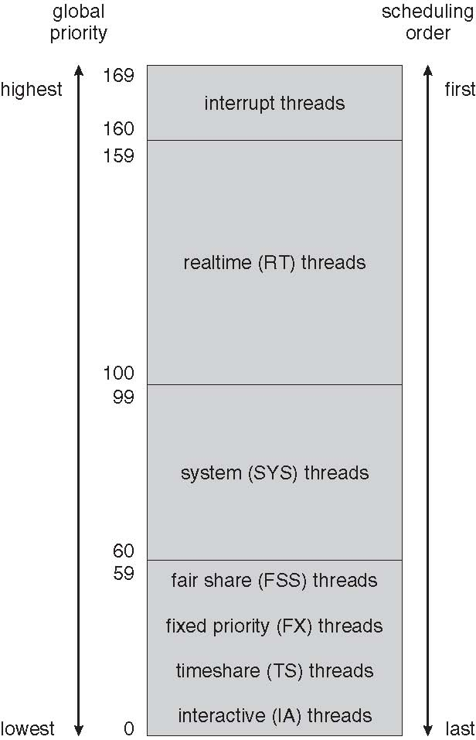
Solaris Scheduling
Notes:
全部的Pri是 0 ~ 169

Slide 47
Windows XP Scheduling
Windows XP schedules threads using a priority-based, preemptive先買權 scheduling algorithm.
Ensures the highest-priority thread will always run.
Dispatcher: The portion of the Windows XP kernel that handles scheduling. 分配器
A thread selected to run will run until it is preempted先佔 by a higher-priority thread, until it terminates, until its time quantum ends, or until it calls a blocking system call.

Slide 48
Windows XP Scheduling
32-level priority scheme.
Divided into two classes
Variable class: threads with priorities 1-15
Real-time class, 16-31
Priority 0 for memory management thread 記憶體管理 系統本身用
Idle thread: If no ready thread is found, execute the idle thread.

Slide 49
Windows XP Scheduling
The Win32 API identifies several priority classes to which a process can belong:
REALTIME_PRIORITY_CLASS
HIGH_PRIORITY_CLASS
ABOVE_NORMAL_PRIORITY_CLASS
NORMAL_PRIORITY_CLASS
BELOW_NORMAL_PRIORITY_CLASS
IDLE_PRIORITY_CLASS
Priorities in all classes except the REALTIME即時的_PRIORITY_CLASS are variable, the priority of a thread belonging to one of these classes can change.
Notes:
Real time 的類別不會轉成其他pri的類別 其他pri可互相調整轉換

Slide 50
Windows XP Scheduling
A thread within a given priority class also has a relative priority :
TIME_CRITICAL
HIGHEST
ABOVE_NORMAL
NORMAL
BELOW_NORMAL
LOWEST
IDLE
Notes:
6x7

Slide 51
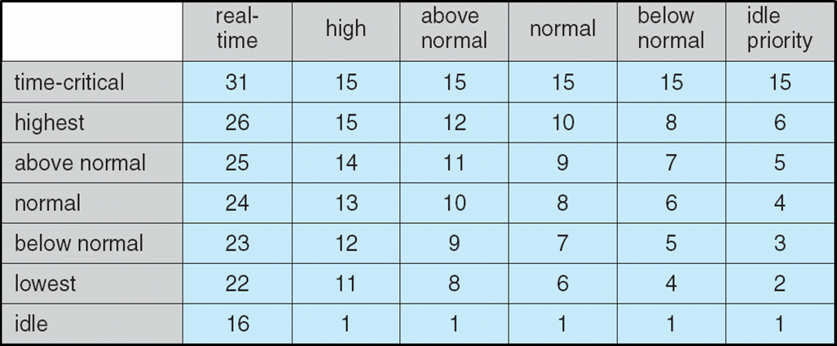
Windows XP Priorities 6x7
Priority Classes
Notes:
Ex一開始一個proc進來 給他初始 base priL Normal XP也有調整的機制 類似solaris的等級 越優先執行時間短 完全用完降級 沒用完升級

Slide 52
Windows XP Scheduling
Each thread has a base priority representing a value in the priority range for the class the thread belongs to.
The base priority is the value of the NORMAL relative priority for that class.
The base priorities:
REALTIME_PRIORITY_CLASS -- 24
HIGH_PRIORITY_CLASS -- 13
ABOVE_NORMAL_PRIORITY_CLASS -- 10
NORMAL_PRIORITY_CLASS -- 8
BELOW_NORMAL_PRIORITY_CLASS -- 6
IDLE_PRIORITY_CLASS -- 4

Slide 53
Linux Scheduling
Constant order O(1) scheduling time regardless of the number of tasks on the system. 不管有多少proc 排程時間都一樣快
The Linux scheduler is a preemptive, priority-based algorithm with two separate priority ranges: a real-time range from 0 to 99 and a nice value from 100 to 140
These two ranges map into a global priority scheme wherein numerically lower values indicate higher priorities. 數字低優先
Unlike Solaris and Windows XP, Linux assigns higher-priority tasks longer time quanta. 相反於前兩個
Notes:
優先高又給時間長 > 1互動性很強>一下就產生IO>就離開結束 2 CPU bound> 就可以拿到比前兩個更久的CPU執行時間

Slide 54
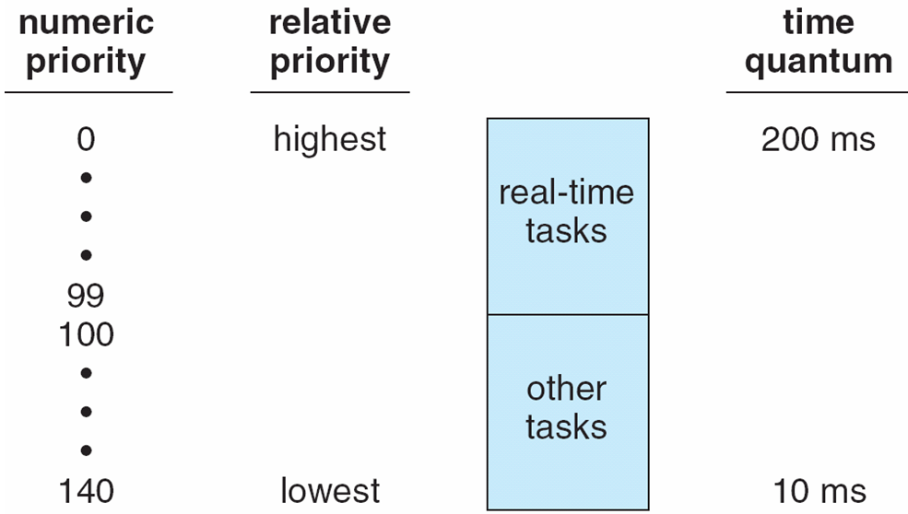
Priorities and Time-slice length
Notes:
高pri時長 反之

Slide 55
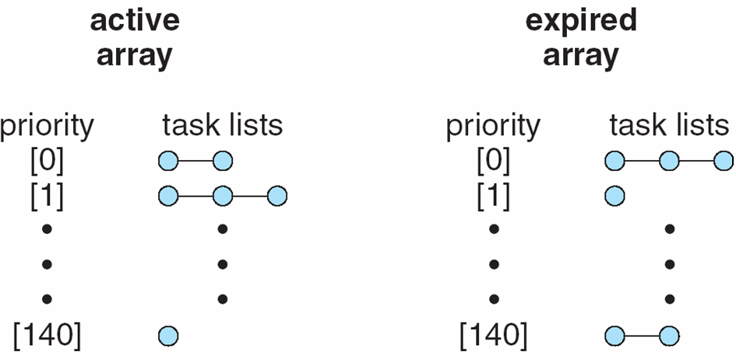
List of Tasks Indexed According to Priorities
The scheduler chooses the task with the highest priority
from the active array for execution on the CPU.
When all tasks have exhausted their time slices (active array is empty), the two priority arrays are exchanged.
Notes:
資料結構就用一些linked list 左邊的依pri挑最優先的執行 給他一個CPU時間 不管有沒有花完 有花完 或產生IO中途離開 就都放到右邊 左邊的全都跑完後 右邊的換到左邊

Slide 56
Algorithm Evaluation
Criteria
Maximizing CPU utilization under the constraint that the maximum response time is 1 second
Maximizing throughput such that turnaround time (on average) linearly proportional to total execution time
Deterministic modeling
Queueing models
Simulations
Implementation
Notes:
Deterministic 確定性的 不包含任何隨機成份的

Slide 57
Algorithm Evaluation
One major class of evaluation methods is analytic evaluation.
Analytic evaluation uses the given algorithm and the system workload to produce a formula or number that evaluates the performance of the algorithm for that workload.
Deterministic modeling is one type of analytic evaluation – takes a particular predetermined預先決定 workload and defines the performance of each algorithm for that workload
Example
Notes:
Workload 工作量 用一個特定量的workoload去跑schedule algorithm來測量performance

Slide 58
Deterministic modeling
Process | Burst Time
P1 | 10
P2 | 29
P3 | 3
P4 | 7
P5 | 12
Minimum average waiting time ?
FCFS
SJF
RR (quantum = 10 milliseconds)
Notes:
用一個特定的工作 去跑algo 再測量表現

Slide 59
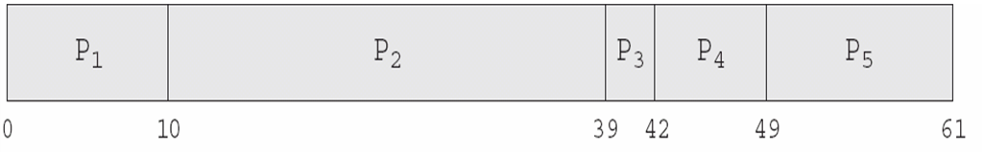
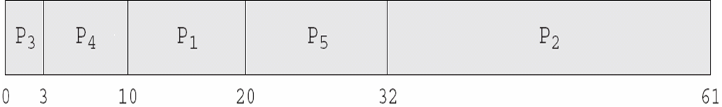
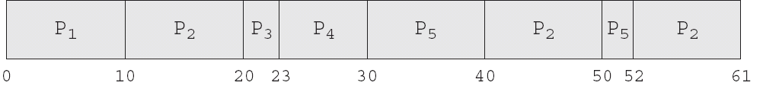
Deterministic modeling
FCFS, AWT = (0+10+39+42+49)/5 = 28
SJF, AWT = (10+32+0+3+20)/5 = 13
RR, AWT = (0+32+20+23+40)/5 = 23
Notes:
SJF最好

Slide 60
Queueing models
On many systems, the processes that are run vary from day to day, so there is no static set of processes to use for deterministic modeling.
實際工作上每天proc順序都不太一樣
What can be determined is the distribution of CPU and I/O bursts.
These distributions can be measured and then approximated or simply estimated – a mathematical formula describing the probability of a particular CPU burst.
Commonly, this distribution is exponential and is described by its mean.
Notes:
distribution of CPU and I/O bursts.例如exponential distribution 或proc一下子進來一堆 或平均一個個慢慢進來

Slide 61
Exponential distribution
https://zh.wikipedia.org/wiki/%E6%8C%87%E6%95%B0%E5%88%86%E5%B8%83

Slide 62
Queueing models
Similarly, we can describe the distribution of times when processes arrive in the system (the arrival-time distribution).
Based on these two distributions, it is possible to compute the average throughput, utilization, waiting time, and so on for most algorithms.
Queueing-network analysis也是一門專門的學問: the computer system is described as a network of servers. Each server has a queue of waiting processes
CPU – ready queue
I/O system --- device queues
Notes:
the distribution of times when processes arrive in the system two distributions: 1 distribution of CPU/IO burst 2 proc到達/產生的頻率時間

Slide 63
Queueing models
Knowing arrive rates and service rates, we can compute utilization, average queue length, average wait time, etc.
Let n be the average queue length (excluding the process being serviced)
Let W be the average waiting time in the queue
Let λ be the average arrival rate for new processes in the queue (such as 3 processes per second)
Little’s formula: n = λ x W
We expect that during the time W that a process waits, λ x W new processes will arrive in the queue. If the system is in a steady穩定 state, then the number of processes leaving the queue must be equal to the number of processes that arrive.
Notes:
1秒來兩個 等待時間5秒 5秒就來10個 5秒過了前面的都進去處理了 後面就又來10個 > n = L x W 我看完公式沒看最後一段自己想的 和最後一段相同 讚讚
steady 穩固的平穩的

Slide 64
Queueing models
Little’s formula can be used to compute one of three variables if we know the other two.
For example, n = 14, λ = 7, then we have W = 2
Queueing analysis also has limitations
Arrival and service distributions are often defined in mathematically tractable馴良易處理的 – but unrealistic – ways.
Generally necessary to make a number of independent assumptions, which may not be accurate.
Queueing models are often only approximations近似 of real systems.

Slide 65
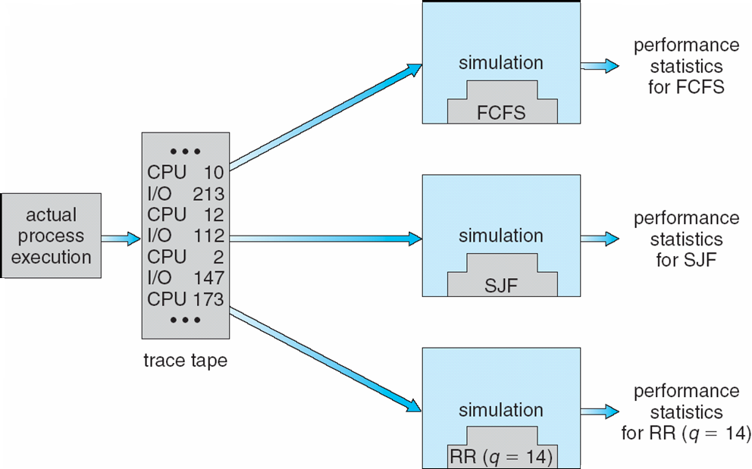
Evaluation of CPU schedulers by Simulation
Notes:
Evaluation n. 不是真正在跑 是模擬 餵很多種模擬資料去跑
評估；估價，評價；估算

Slide 66
End of Chapter 5

